Slide 1

Bank Transaction Classification
Assessment Review
Prepared By: Faiq Adzlan

Slide 2



Business Problem.
Develop an ML model that reliably labels bank transactions from which we can base our advice on
Assist customers in
understanding their spending patterns
Provide personalized recommendations/financial advice based on spending habits

Slide 3
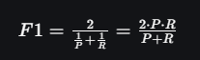
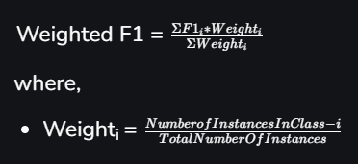
Model Evaluation Metrics.
To achieve the 2 goals stated earlier, our multi-class classification model ought to be benchmarked accordingly. Here, we use the F1-Weighted score for the following reasons:
Both false positives and false negatives impact our ability to give sound financial advice which is why we opt for a metric that balances both of them.
As for why we opted for weighted instead of the default F1-Macro (average of individual F1 scores without weights), a macro-average could overly penalize the model for poor performance on very small/infrequent classes).
F1-Score formula. Source
Weighted F1-Score formula. Source
Notes:
A False Positive could occur if a transaction is incorrectly labeled as Payroll when it actually belongs to the Loans category (poor precision). This might inflate a user’s perceived income, leading to poor financial advice, such as suggesting they have enough income to cover their expenses when they actually do not.
Similarly, a False Negative could occur if a transaction belonging to the Payroll category is mislabeled as something else, such as Miscellaneous (poor recall). This would underestimate the user’s income, potentially causing unnecessary warnings about their financial health or debt levels.
Alternatively, instead of the F1-Score, we could also consider the Average Precision Score, which is somewhat related to the Precision-Recall Area Under the Curve (PR-AUC) metric. However, we instead opt for F1-Score due to the sensitivity of the PR-AUC metric when dealing with highly imbalanced classes.

Slide 4
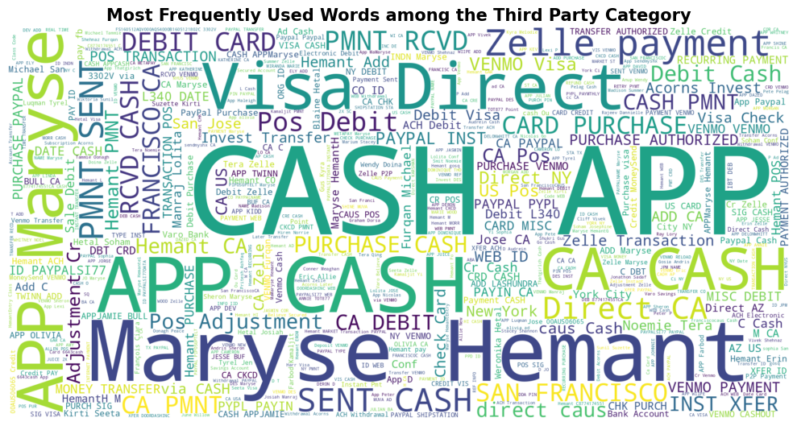
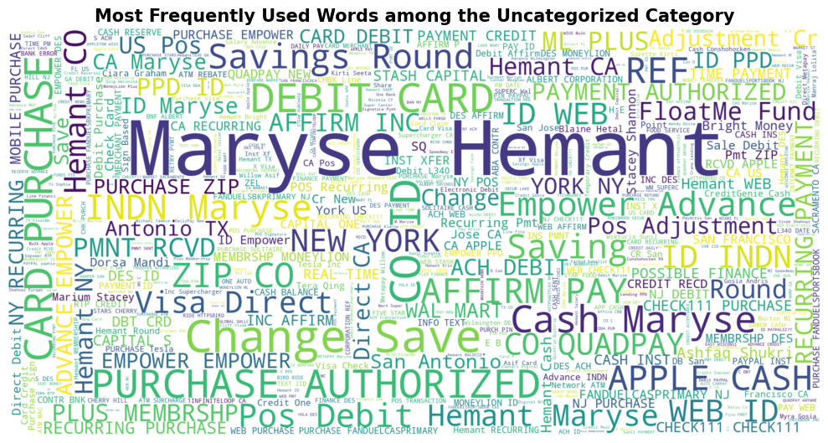
EDA.
Fig. 1. Sample word clouds from the Uncategorized and Third Party category (the 2 most represented categories in the dataset accounting for ~20% of transactions)
Notes:
From our analysis, we find the following:
The word CASH APP seems to be strongly tied to the Third Party category, while PURCHASE AUTHORIZED is to Restaurants/SuperMarkets and Groceries/Convenience Stores, Savings Accounts and Chime Savings is to Transfer Credit, as well as MoneyLion and InstaCash is to Loans.
More needs to be done to analyze the Uncategorized category.

Slide 5
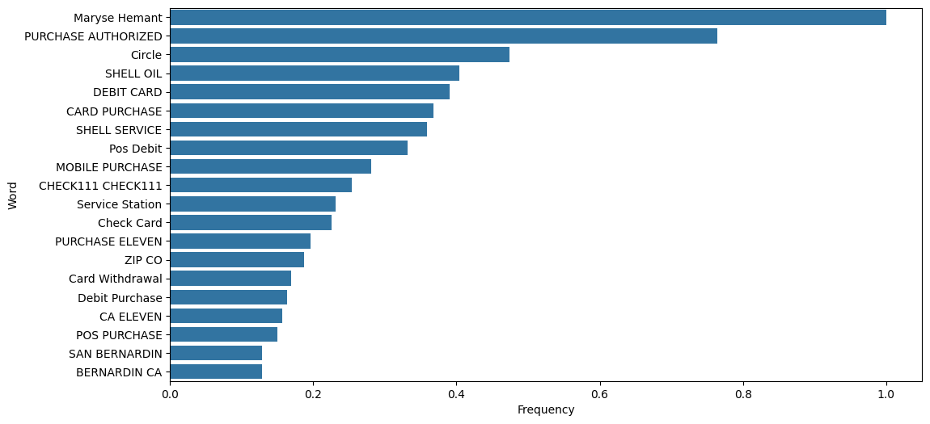
EDA.
Fig. 2. We also identify several stopwords e.g., CHECK111 & Maryse Hemant by analyzing the respective word clouds for every sizeable category*.
Notes:
From our analysis, we find the following:
- The word *Maryse Hemant* appears at the top 3 across several categories e.g., Uncategorized, Third Party, Restaurants, etc.
- Additionally, the word CHECK111 also appears in several transactions as the only word in the description. We treat this as noise and will remove rows containing only this word in our pre-processing. It appears the top 20 word plots for the Restaurants, Convenience Stores & Supermarkets and Groceries category.
*Sizeable Categories refer to the top 7 categories with the most transactions (due to them accounting for 60% of transactions.

Slide 6
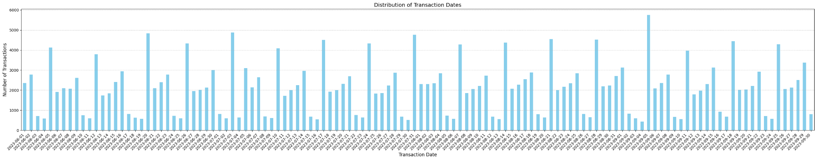
EDA.
Transactions peak on Mondays
Fig. 3. illustrates a seasonal pattern where we find that transaction volume peaking on Mondays, followed by Fridays, and tapering down significantly on weekends.
Transactions taper down significantly during the weekends

Slide 7
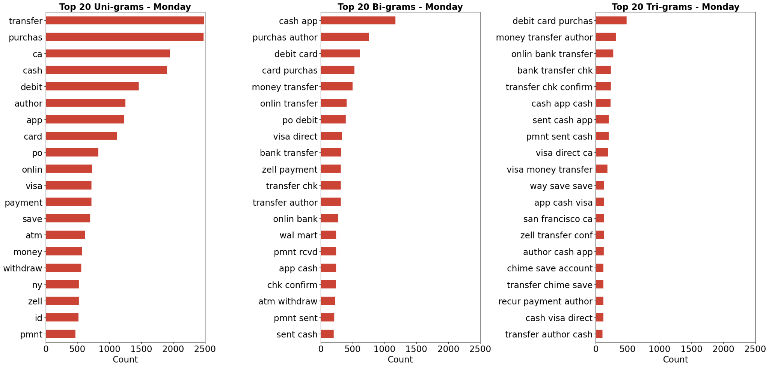
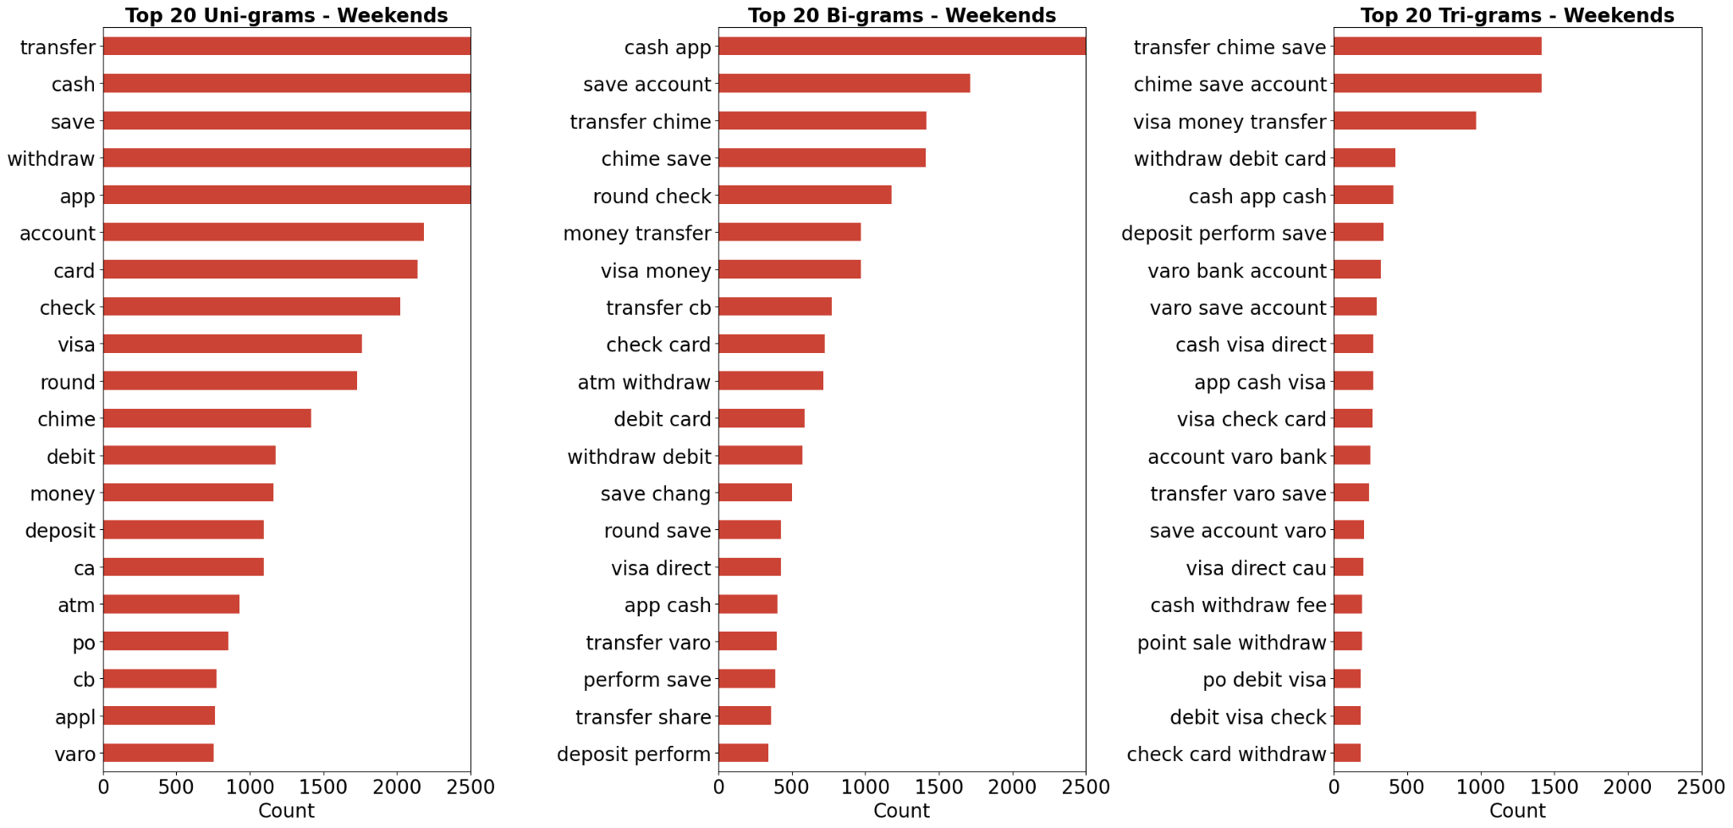
EDA.
Fig. 4. We can see that a whole lot more inflows e.g., Transfer Credits happen during the weekend in comparison to Mondays (which see a lot of outflows) based on our tri-gram analysis

Slide 8
Pre-processing & Feature Engineering.
Text-related pre-processing
We first removed rows with null values in the category column from the bank_transaction.csv
We then pre-processed our dataset using the stem_text() function which performs: Non-Letter Removal; Case Normalization; Tokenization; Stopword Removal; Stemming. We did this to identify transactions comprised of only stop words, non-alphanumerics and numbers-only (which we then remove as they are not meaningful).
Transaction-level features
We then created day related features to identify if the transaction happened on Friday, Monday or the weekend based on our EDA.
We also chose to keep the amount spent column on the transaction. Sizeable amounts may be correlated to specific transaction categories.*
*A mistake we did was forgetting to scale the numerical columns beforehand e.g., amount vs transaction count, etc.This resulted in exploding gradients later on

Slide 9
Pre-processing &
Feature Engineering (cont.).
User-level features
From bank_transaction.csv, we created aggregate features to determine, on a monthly basis, how likely a consumer is to make a transaction of a particular category based on their count. This can potentially capture a transaction category a user has a proclivity for.* We acknowledge that this may result in a sparse dataset, but it's a good first step for experimentation.
From user_profile.csv, we included the intent columns in spite of their sparsity for experimentation.
Train-test Split
20% of the original dataset was set aside and used as a test set. This was useful in evaluating our model's performance on unseen data.
We also used stratification to preserve the class representation in our train and test set. However, due to the imbalanced nature of the categories in our dataset, we've had cases where there's only 1 instance of a category in our test set e.g., Tax Refund.
*A mistake we did was forgetting to scale the numerical columns beforehand e.g., amount vs transaction count, etc.This resulted in exploding gradients later on

Slide 10
Model Choice & Training Loop.
We trained 2 models using Google Colab Pro's A100 GPU (40GB VRAM). One model takes in text primarily as input, and the other takes text and additional non-text features. Both were trained using PyTorch and had the following training procedures:
Learning Rate Scheduler
ReduceLROnPlateau: To dynamically reduce the learning rate when the F1 score plateaus, helping the model converge without overfitting.
Gradient Clipping
torch.nn.utils.clip_grad_norm_: To limit the gradient norm to 5.0, preventing exploding gradients and stabilizing training.
Early Stopping
current_patient and patient: To stop training if validation F1 score doesn’t improve for 3 consecutive epochs, reducing overfitting from excessive training.
Validation Monitoring
Regular evaluation on validation data (test_X and test_Y) was done to ensure overfitting was detected early.*
Weight Decay via AdamW
Optimizer includes weight decay, indirectly acting as L2 regularization to reduce overfitting.
*A mistake we did was forgetting to print the Training dataset metrics as well.
Notes:
Future features
Auto client servicing
Full automation of digital marketing using AI algorithms
Auto optimisation of digital ads
Automated B2C to allow individual user to pick creative art, copywriting & data packets through check-outs

Slide 11
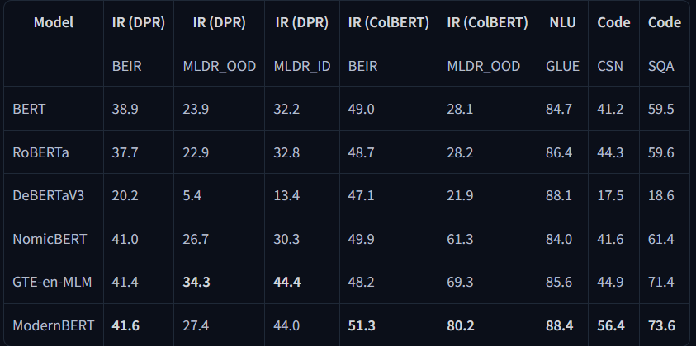
Model Choice & Training Loop.
Fig. 5. DeBERTaV3 vs other models on various benchmarks (especially the relatively new ModernBERT). Source
Notes:
We chose the latest version of DeBERTa due to it's relatively good performance on NLU (Natural Language Understanding) tasks and benchmarks. Moreover, with a vocabulary of 128k and only having 86 million backbone parameters, it is relatively efficient to finetune which is good due to our compute constraints.
How BERT works:
https://www.youtube.com/watch?v=xI0HHN5XKDo
How DeBERTa is different from BERT:
Disentangled Attention: each input word is represented using two separate vectors that encode a word’s content and position. The key difference is that instead of adding the two vectors we treat them separately throughout the network. Hence, for every word (and between words) the Transformer learns: context-context portion (essentially mapping the semantic relation between the meaning of the two words i and j), context-position portion (a map of how the context of the word i is related to the relative position vectors of the words around it) and the position-context embedding (a map of how the relative position of the word i relates to the context of the word j).
Enhanced Masked Decoder (EMD): DeBERTa captures the relative positions in all the transformer layers and only uses absolute positions as complementary information when decoding the masked words. Thus, the name enhanced masked decoder.
Since the model has access to only the relative positions and not the absolute positions it can be a problem in ambiguous cases. The absolute positions need to complement the relative position embeddings to completely understand the spatial modality.
BERT ingests the absolute position in the input layer itself. To give the model some context of the actual positions, the authors add them right after all the transformer layers but before the softmax layer for masked token prediction.
Source: https://wandb.ai/akshayuppal12/DeBERTa/reports/The-Next-Generation-of-Transformers-Leaving-BERT-Behind-With-DeBERTa--VmlldzoyNDM2NTk2

Slide 12
Results & Next Steps.
Fig. 6. From the above results, our text-only model dominates, especially when comparing F1-Macro. When looking at categories where there 0 transactions were correctly identified, the text-only model only has 1 (Tax Refund) while the text/non-text feature model has 4 (Bank Fee, Interest, Payment, Tax Refund). Additionally, all but 2 categories for the text-only model have less than 70% F1 Score for every class. However, we are unable to identify if the model overfit or not due to not recording the Training dataset metrics (in the training loop) which is a mistake. We can of course rerun this.

Slide 13
Results & Next Steps.
For improving the DeBERTaV3 (Text & Non-text) model
Normalizing & scaling extra_data (especially the amounts & monthly_transaction_count_{category}) column which have a lot of outliers) before concatenation for smoother training.
Add batch normalization after our dense layer for extra stability. This is especially the case as our gradients for the Text/Non-text model were quite big.
We can train different models that either discard/adopt the user-level features e.g., `monthly_transaction_count_{category}` & `IS_INTERESTED_{category}` or create features based on monthly transaction amount.
However, it may be wise to focus on iterating on the text-only model due to its success.

Slide 14
Results & Next Steps (cont.).
Resampling & Stop words
More data (1 month to 3 months on) can help uncover more stop words.
For example we can downsample overrepresented classes such as Uncategorized and upsample smaller classes like Gyms and Fitness Centers, Tax Refund, etc.
In the training loop, we ought to:
Monitor performance metrics on the Training data as well to identify overfitting.
StratifiedKFold (Cross-validation) can also be used to provide a more reliable estimate of a model's performance.
MLOps tools like Weights & Biases can help automate the monitoring process.
Conduct False Positive analysis where we examine incorrect positive predictions to understand their causes, impact, and potential ways to reduce them.
Explore different architectures e.g., ModernBERT, Classical Bag-of-Words models, etc.
Notes:
*This is done by training and evaluating it on multiple different subsets of the data.

Slide 15
Thank
You.

